Slide 1

RC CAR WORKSHOP

Slide 2
What is a Microcontroller???
A microcontroller (MCU for microcontroller unit) is a small computer on a single integrated circuit.
It has inbuilt memory(RAM & ROM), I/O Ports, Timers, Serial Port etc.
Used in specific applications demanding low computation power
Very cost effective
Low power consumption

Slide 3

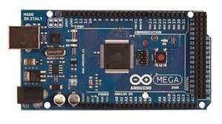
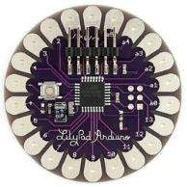
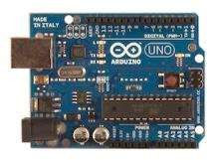
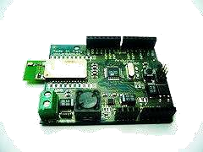
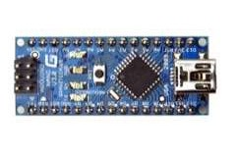
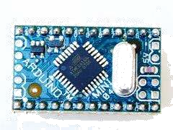
Arduino Boards:
UNO
Mega
LilyPad
Arduino BT
Arduino Nano
Arduino Mini

Slide 4
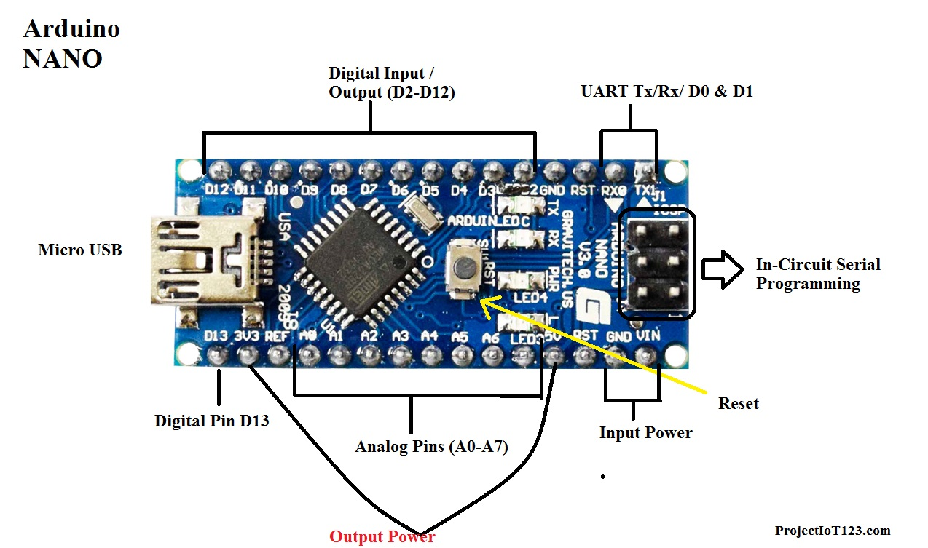
Arduino Nano:

Slide 5
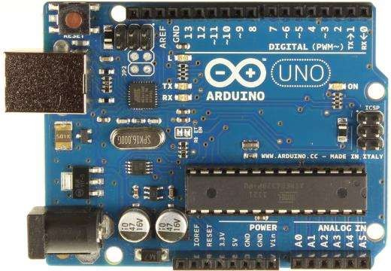
Arduino UNO:
Digital output
~: PWM.
0,1: Serial port.
In circuit Serial programming
Atmel MicroController
USB port
Power input
Analog input.
Power Supply

Slide 6
BAUD RATE
The baud rate specifies how fast data is sent over a serial line. It’s usually expressed in units of bits-per-second (bps).
Baud rates can be just about any value within reason. The only requirement is that both devices operate at the same rate.
One of the more common baud rates where speed isn’t critical, is 9600 bps. Other “standard” baud are 1200, 2400, 4800, 19200, 38400, 57600, and 115200.

Slide 7
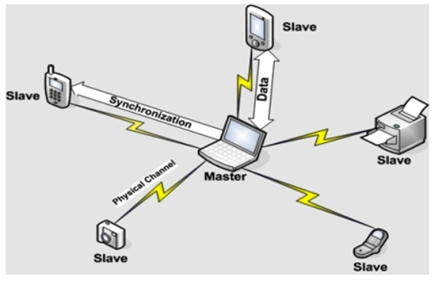
BLUETOOTH
A Bluetooth technology is a high speed low powered wireless technology link that is designed to connect phones or other portable equipment together. It is a specification for the use of low power radio communications to link phones, computers and other network devices over short distance without wires. Wireless signals transmitted with Bluetooth cover short distances, typically up to 30 feet (10 meters).

Slide 8
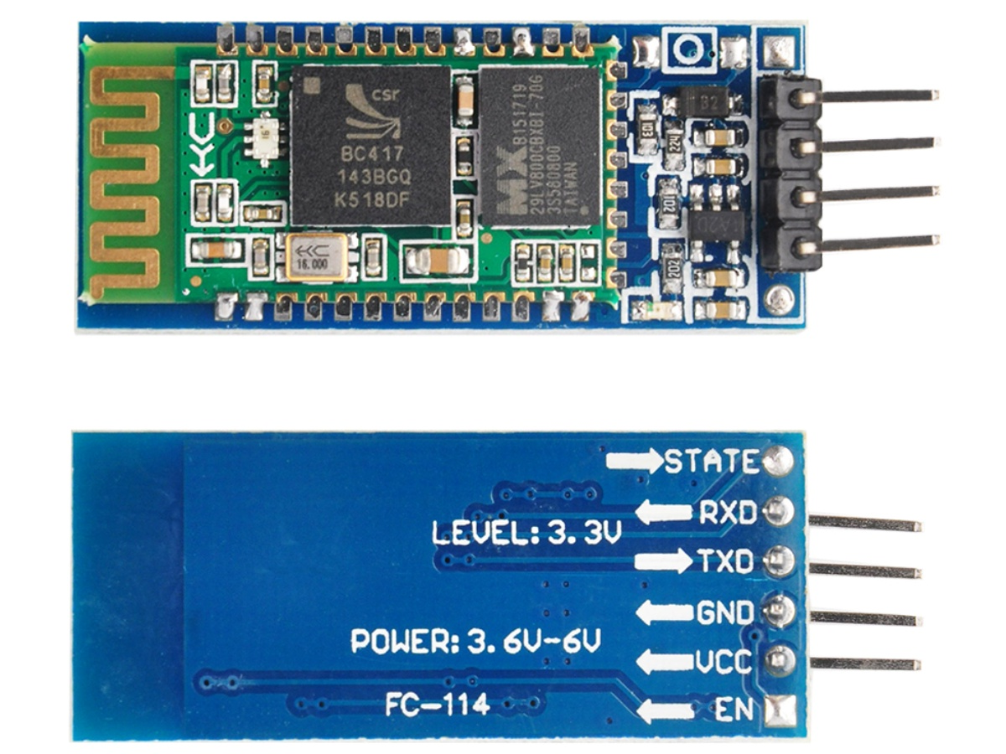
BLUETOOTH MODULE(HC-05)

Slide 9
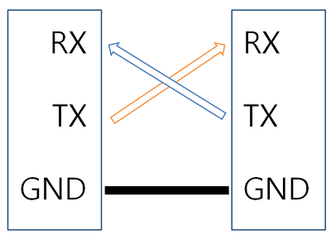

Slide 10
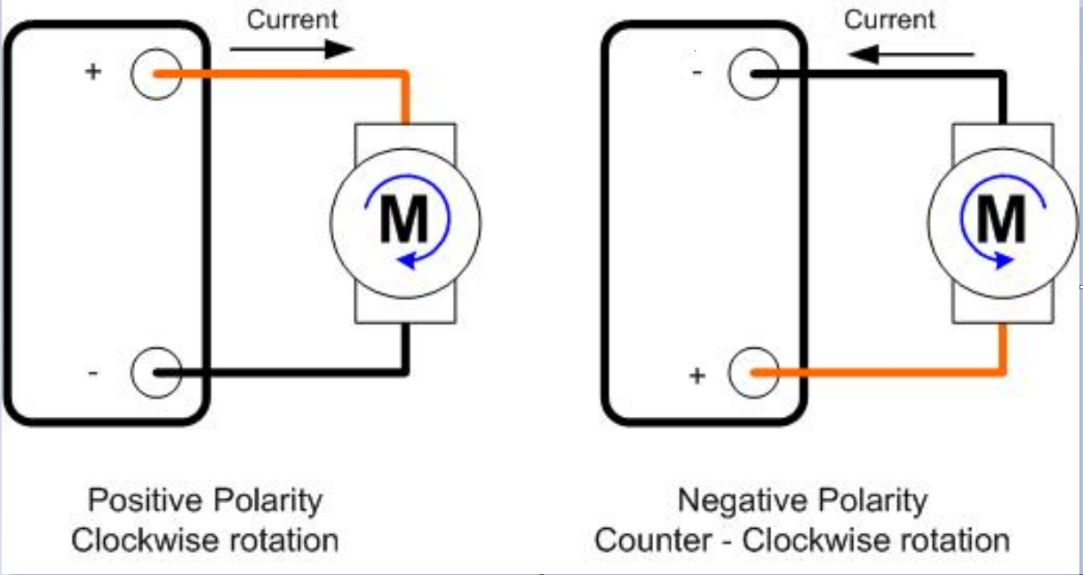
DC MOTOR ROTATION

Slide 11
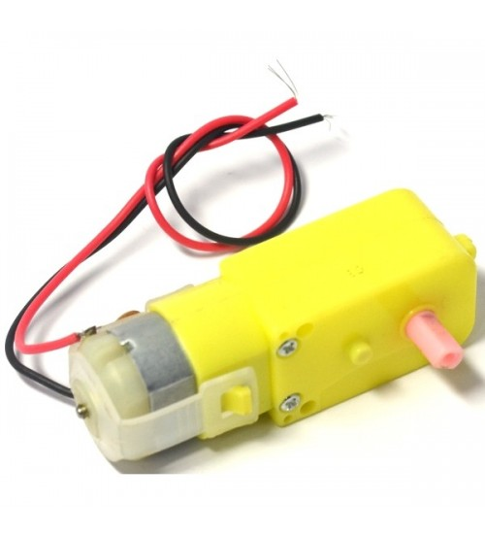
B O MOTOR

Slide 12
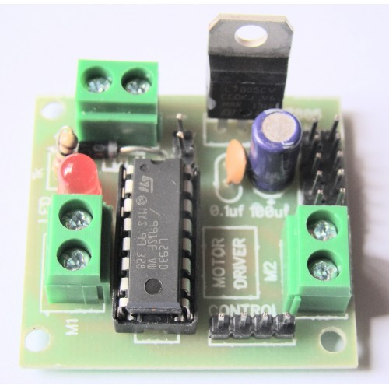
L293D MOTOR DRIVER

Slide 13
THANK YOU

